Slide 1
RESUME REVEALER
MINeD HACKATHON’24
Ensemble Elite
21BCE275 Shah Vraj
21BCE186 Arya Patel
21BCE197 Janam Patel
21BCE210 Nemi Patel

Slide 2
Modules
Parsing Tool
Section Classifier
O-Net Standardization, Occupation Classifier
Skill Extraction

Slide 3
Parsing Tool
Supported Formats: Parses resumes in PDF, DOCX, HTML.
Parsing Tools: Utilizes PyPDF2, docx2text, etc.
Extracted Information: Captures contact details, work experience, education history, and skills effectively

Slide 4
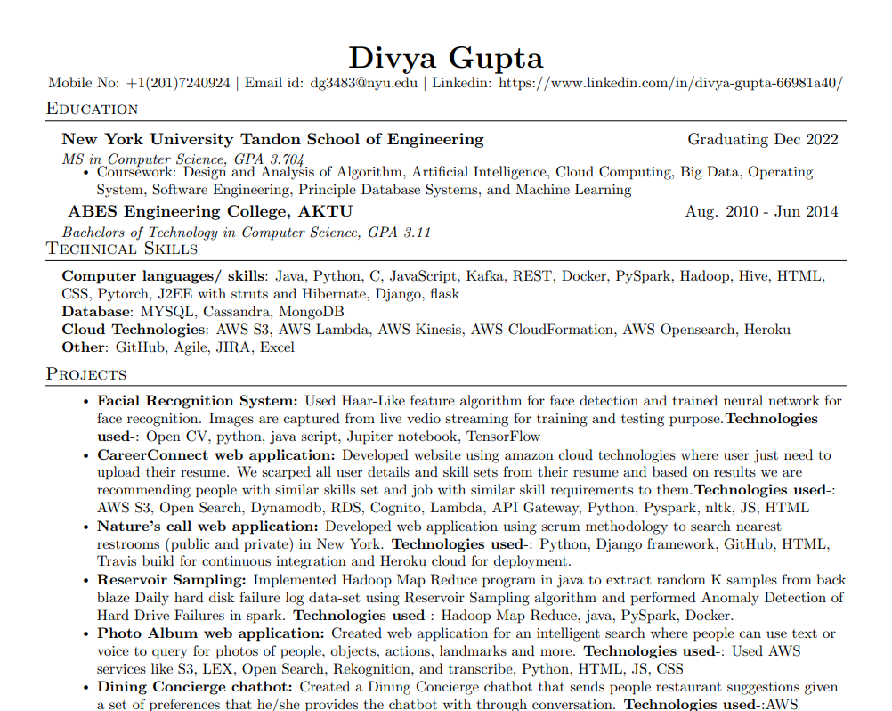
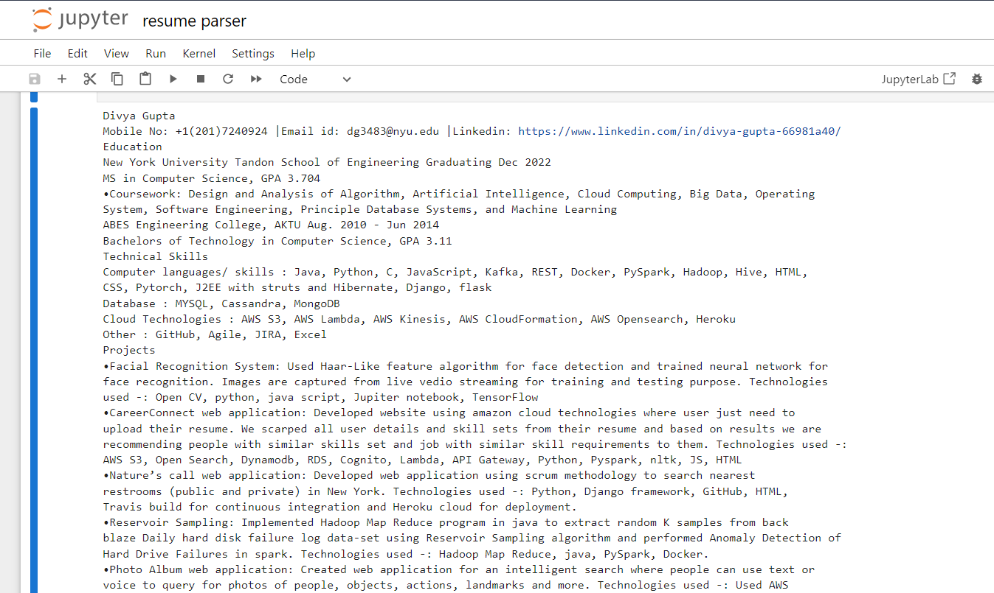
Parsing Tool

Slide 5
Section Classifier
Classify resume sections (education, experience, skills).
Usepre trained BERT model "has-abi/extended_distilBERT-finetuned-resumes-sections"

Slide 6
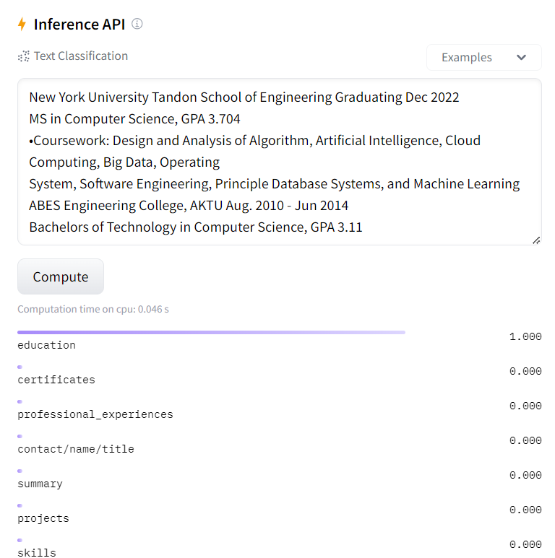
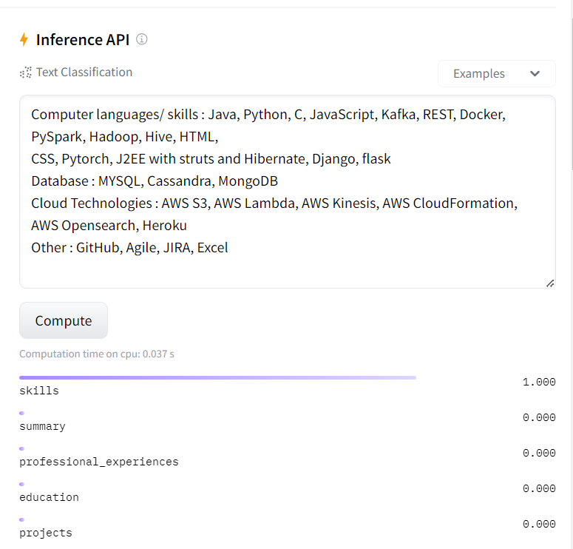
Section Classifier And Ordering based on profiles

Slide 7
O-Net based occupation Classifier
Standardize skills and job titles extracted from resumes according to the O*NET standard.
Onet database based on job description and matching job title, we fine-tuned a transformer model based on given dataset.
The data stored will be summarized and passed onto onet model, which will classify the job title

Slide 8
O-Net based occupation Classifier
Data Source:
Occupational data ("ONET") for model training.
Parsed resume text for Occupation prediction
Model Training:
Data Preprocessing
Encode job titles using LabelEncoder.
Split data into training and testing sets.
Preprocess text using BERT tokenizer
Fine-Tuning BERT:
Use pre-trained BERT model ("bert-base-uncased").
Train the model on encoded training data
Job Title Prediction for Parsed Resume Text:
Standardize skills and job titles extracted from resumes according to the O*NET standard.
Summarize Resume Text:
Use a pre-trained summarization model (e.g., "Falconsai/text_summarization") to generate a concise summary of the parsed resume text.
Process and Predict:
Apply the BERT tokenizer to the generated summary.
Feed the encoded summary to the fine-tuned model.
The model predicts the most likely occupation based on the summary's content.

Slide 9
Skill Extraction
Extract skills mentioned in the resume, including both hard and soft skills.
Use pretrained token classifier.
Data obtained from classification into education,experience,skills, will be forwarded to skill extractor module
Skill Extractor module will extract the skills.

Slide 10
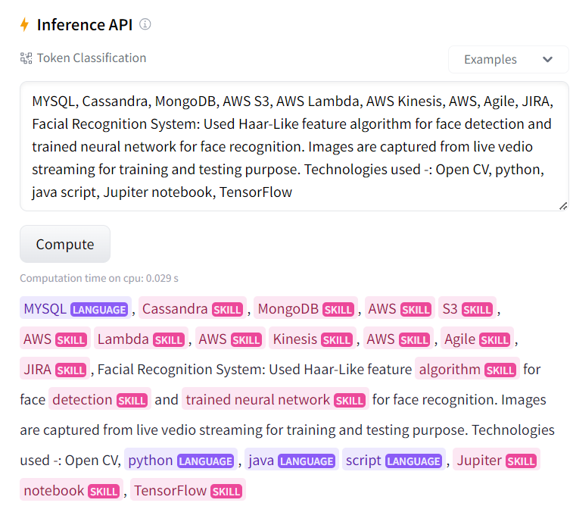
Skill Extraction

Slide 11
Conclusion
Enhanced Efficiency: Automated processing of resumes speeds up the hiring process, enabling the company to handle a large volume of applications efficiently.
Standardization: Predefined templates ensure consistent organization of resume sections, facilitating easier evaluation by recruiters.
Improved Candidate Evaluation: Conversion of resume sections into points allows recruiters to quickly assess candidates based on predefined criteria, leading to more informed hiring decisions.
Streamlined Workflow: Automation reduces administrative burden on recruiters, freeing up time for higher-value tasks and enabling faster response times to candidates

